Slide 1

Hack Night Bern dapr
ti&m
Moritz Baumotte, Martin Kräuchi
Bern, 05. März 2025

Slide 2
Resources
https://github.com/Bern-Hack-Night source, powerpoint
https://dapr.io/ main page
https://dapr.io/learn/ online tools
https://docs.dapr.io/getting-started/ installation
https://www.diagrid.io/dapr-university here we start
https://github.com/dapr
https://github.com/dapr/quickstarts.git

Slide 3
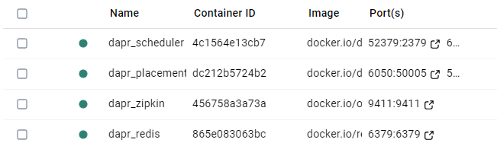
Tooling
install Docker Desktop
install Visual Studio 2022 / IntelliJ / Visual Studio Code + Plug Ins
For Dapr Installation follow https://docs.dapr.io/getting-started/install-dapr-cli/ Hint: start docker desktop before
for Windows:
powershell -Command "iwr -useb https://raw.githubusercontent.com/dapr/cli/master/install/install.ps1 | iex"
dapr –h
dapr init

Slide 4
Agenda
Intro
First demo
doing the Installation and go thourg university example
have a look at a funny example
possible challenges to solve
pizza
working on your challange with your peer
let’s enjoy this evening!

Slide 5












Dapr community
12/157
120
700k+
300k
Largest CNCF project
Community components
Docker Hub pulls/month
Unique doc views/month
📖
29k
3k
7k
GitHub stars
Contributors
Discord members
⭐

Slide 6
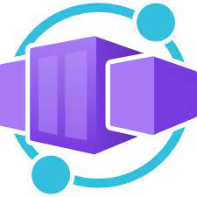







Use Dapr anywhere
Azure Container Apps

Slide 7
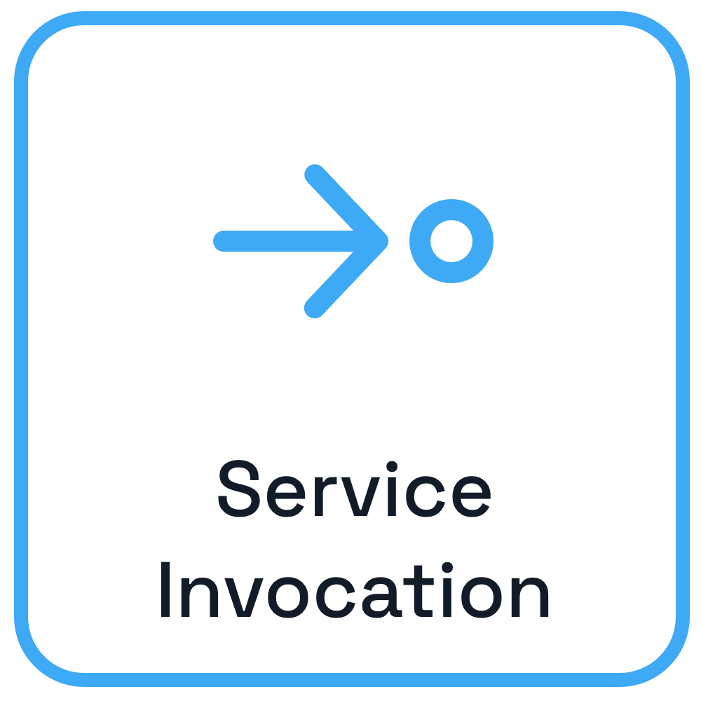

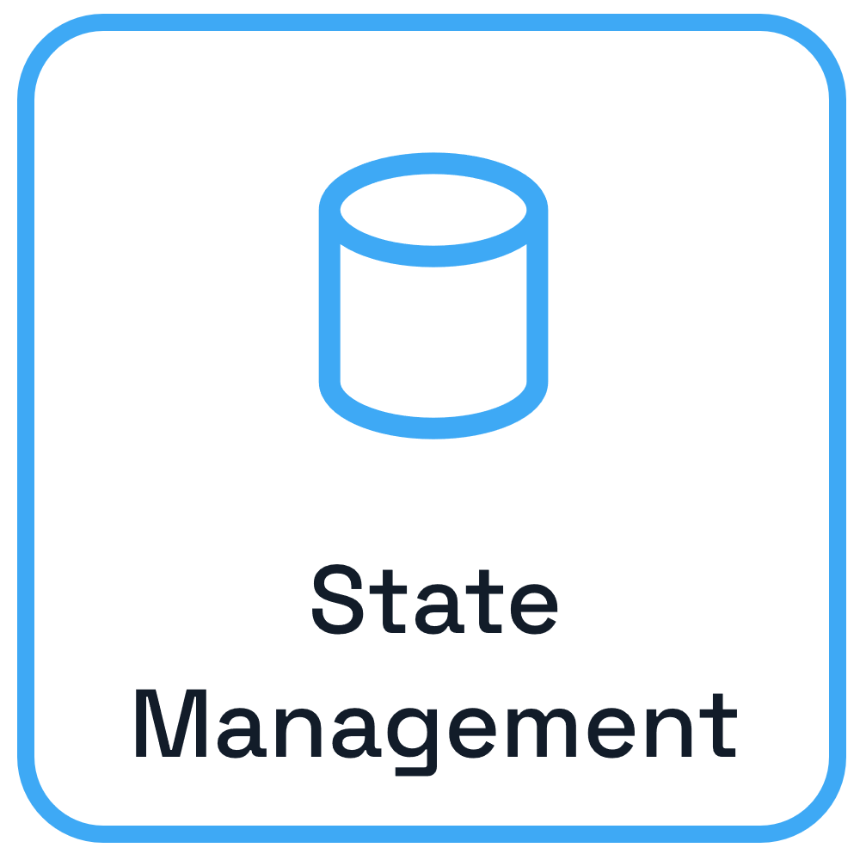
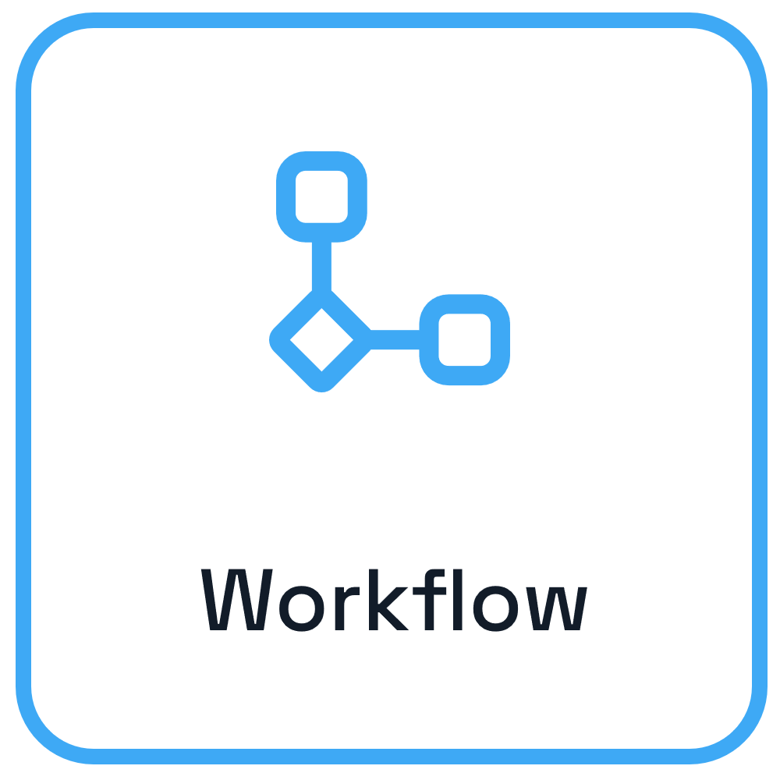


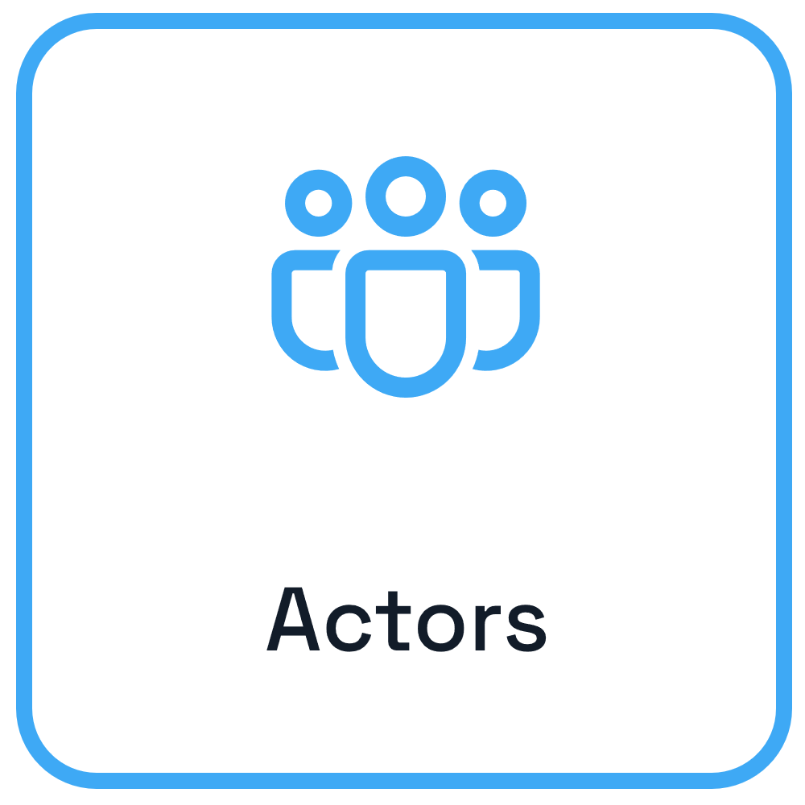
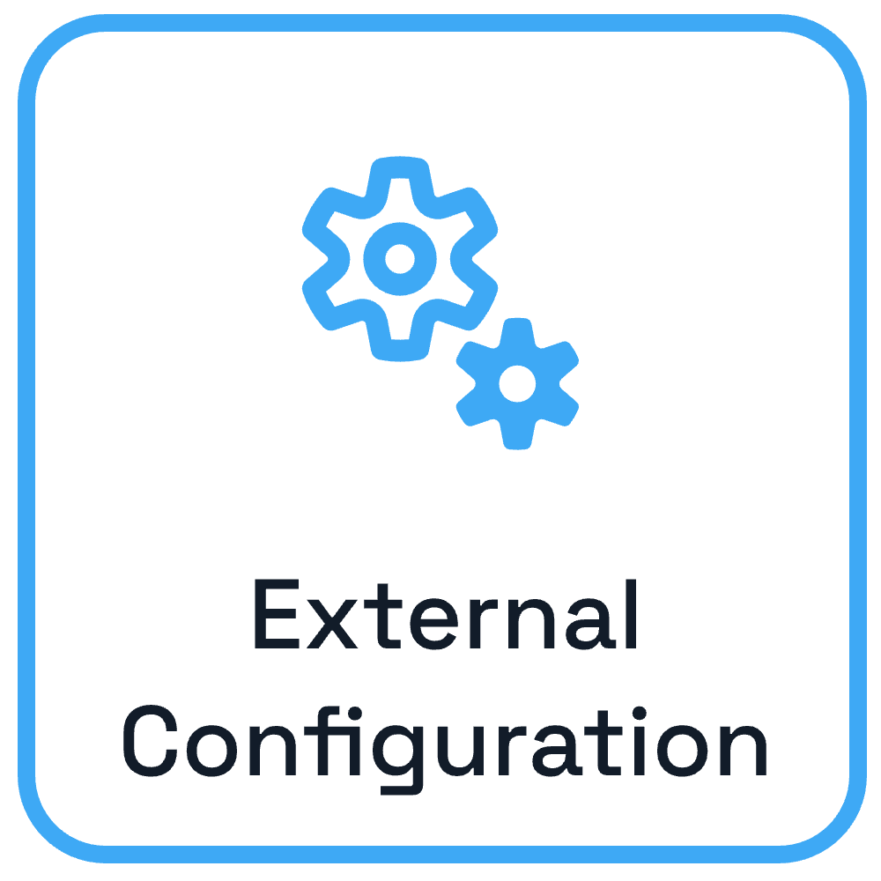
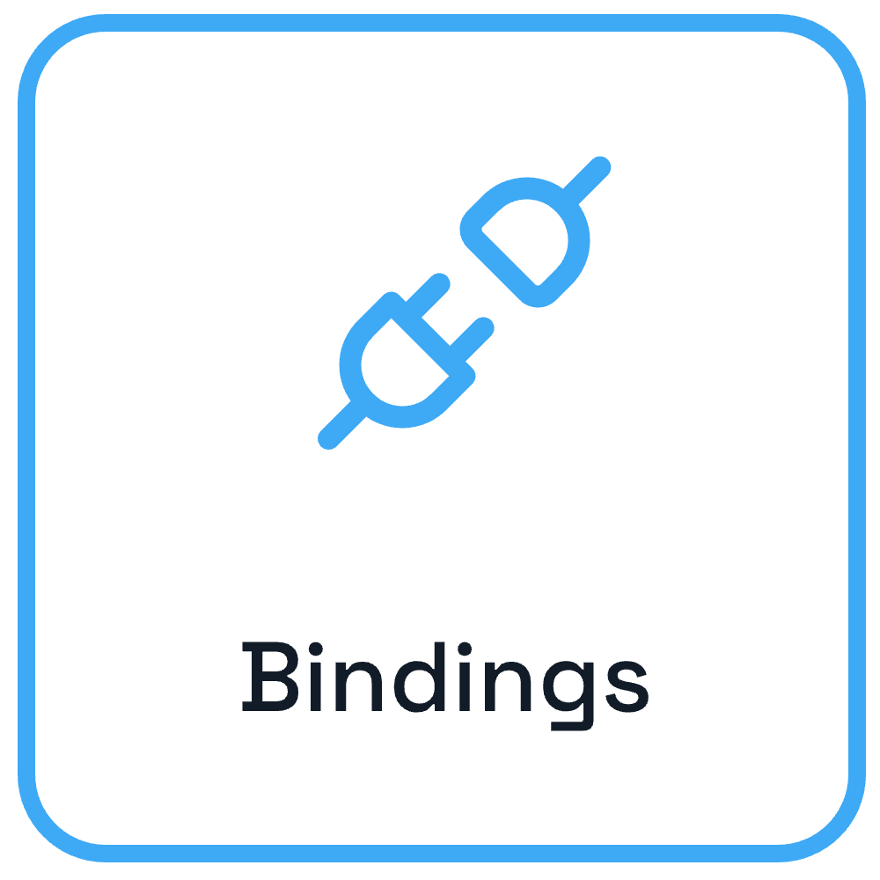


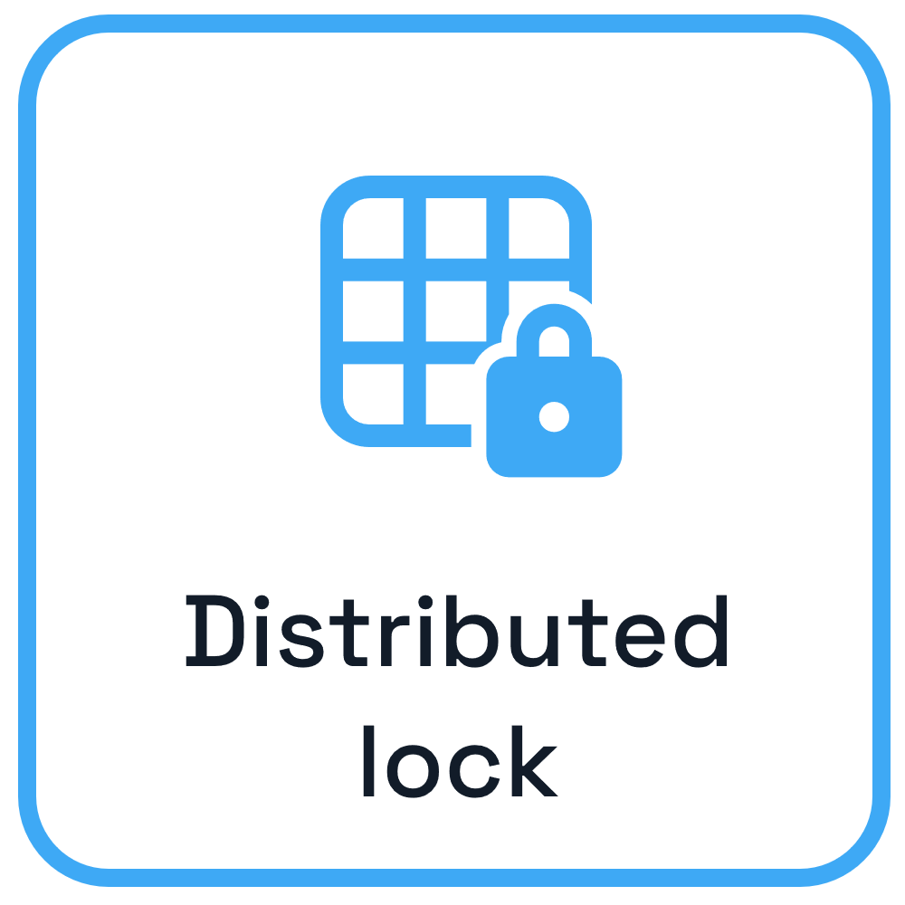




Dapr APIs & Cross cutting concerns
App B
App A
App C

Slide 8
Sidecar pattern and the Dapr API
Dapr API
My App
App
HTTP/gRPC
Application code
Dapr sidecar
POST http://localhost:3500/v1.0/invoke/cart/method/order
GET http://localhost:3500/v1.0/state/inventory/item50
POST http://localhost:3500/v1.0/publish/mybroker/order-messages
GET http://localhost:3500/v1.0/secrets/vault/dbaccess
POST http://localhost:3500/v1.0-beta1/workflows/dapr/businessprocess/start

Slide 9



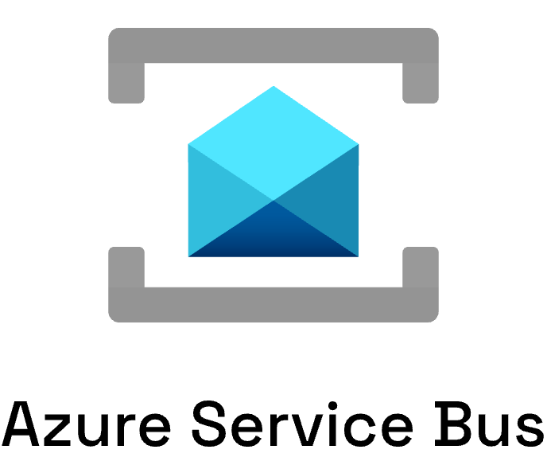

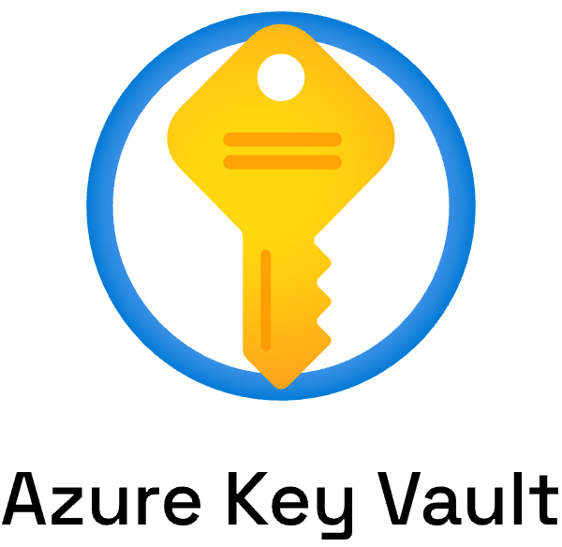


Swappable component model

Slide 10
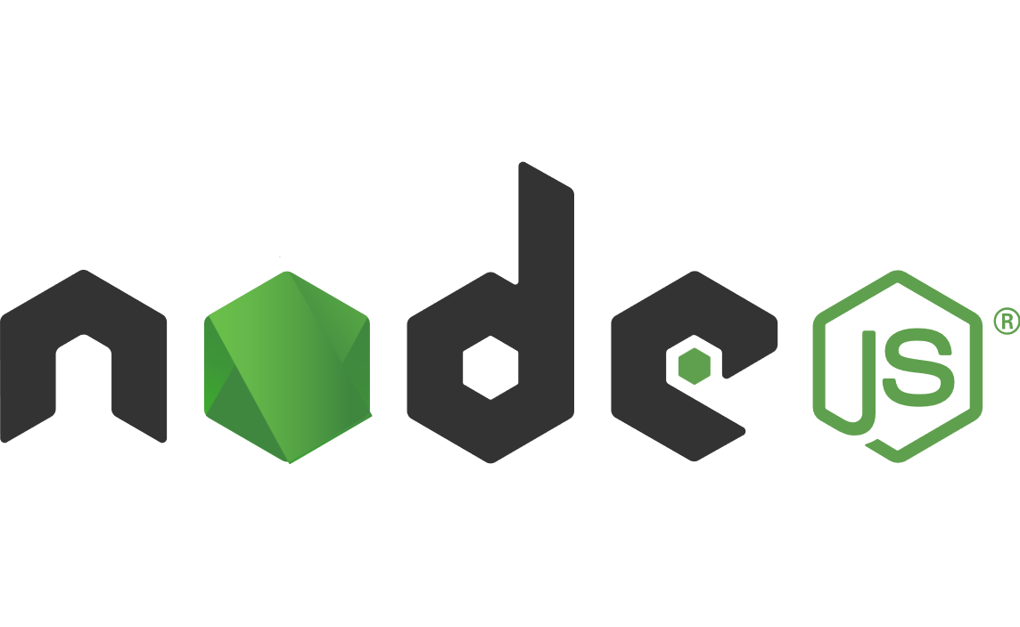


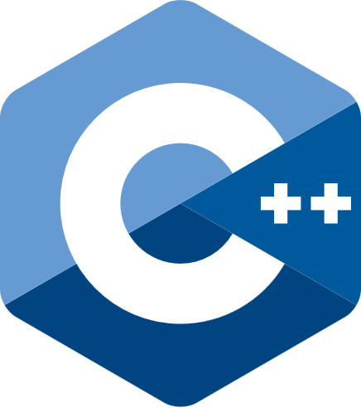




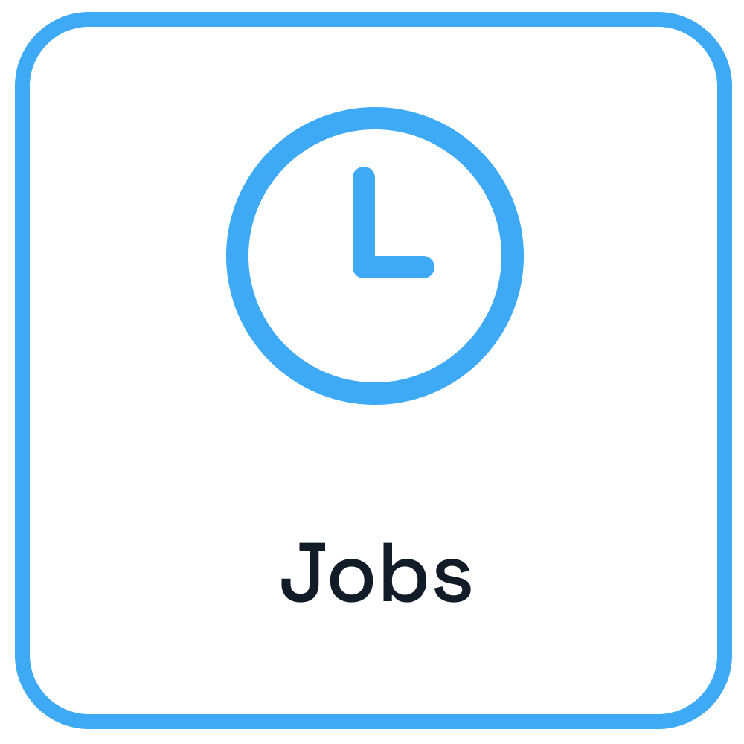
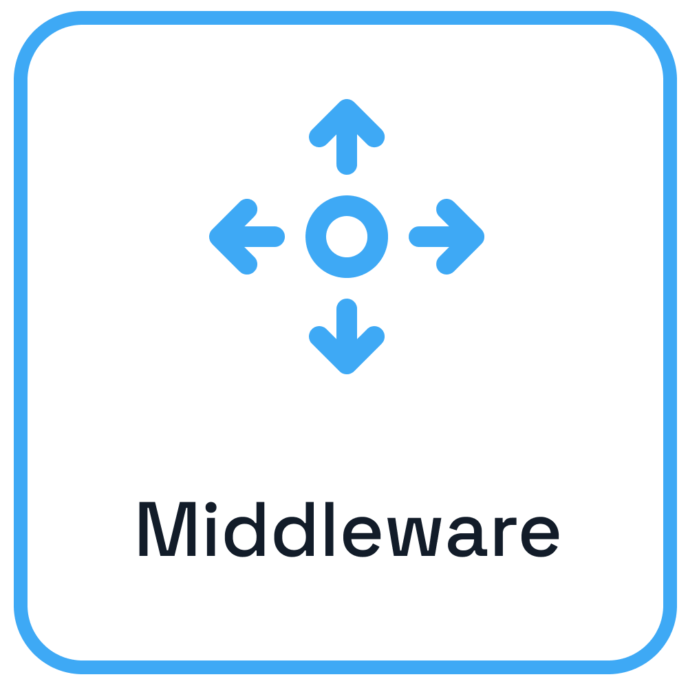




Dapr from development to hosting
Use any language or runtime
App
HTTP/gRPC
Host on & integrate with any cloud or edge infrastructure
Databases
Message Brokers
Services

Slide 11
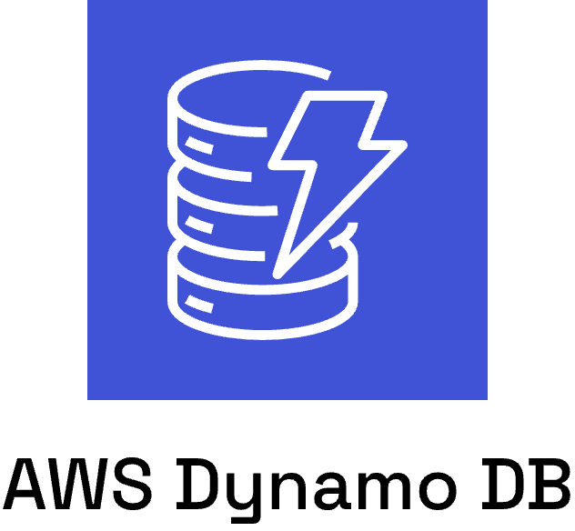



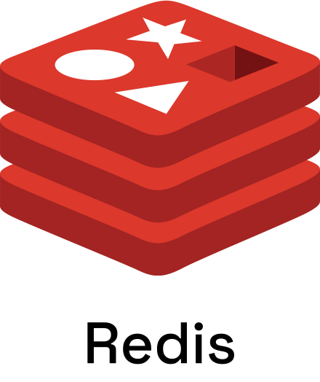

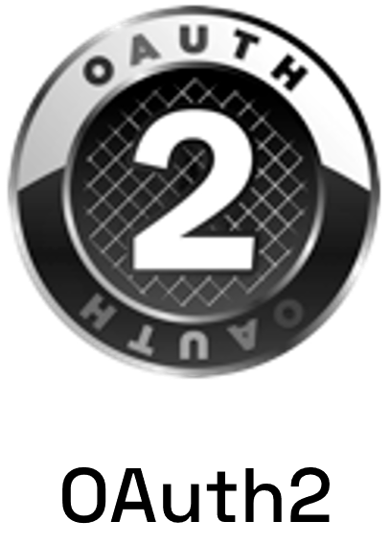
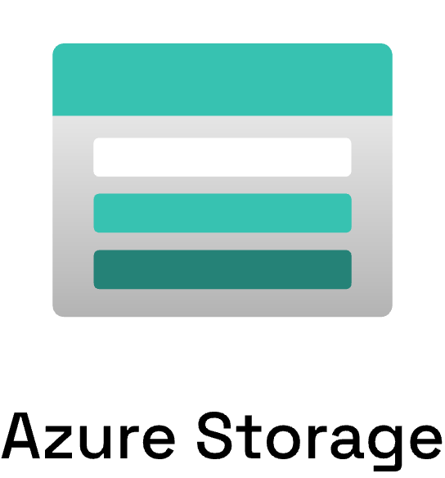
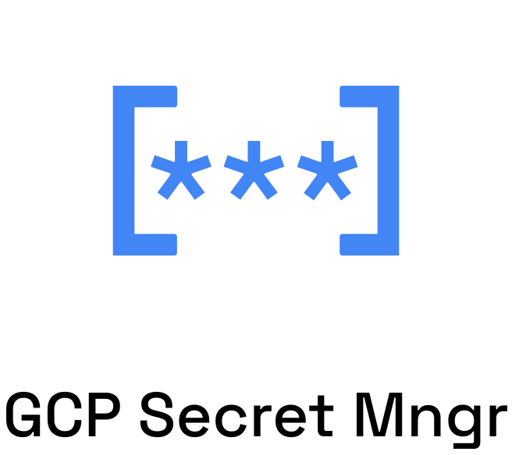
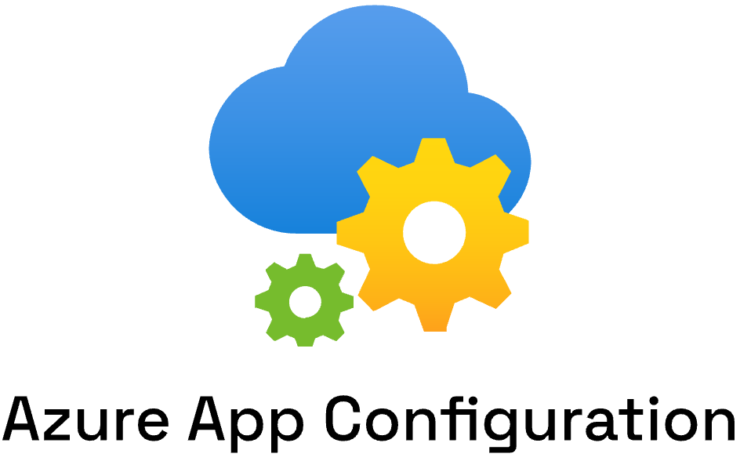
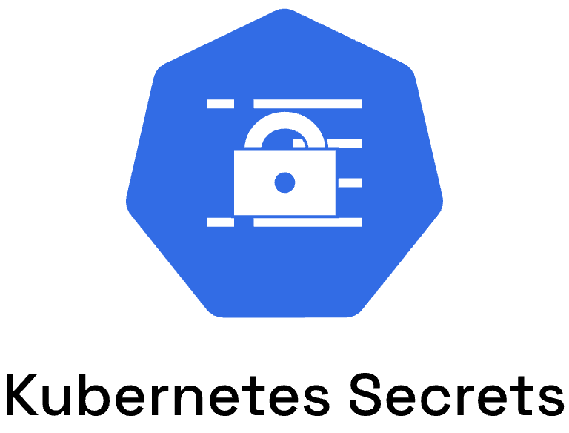


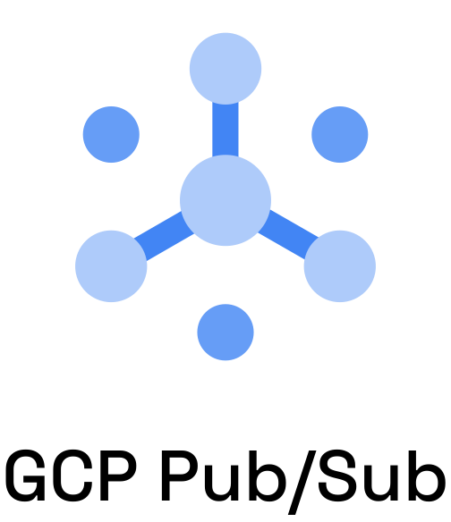
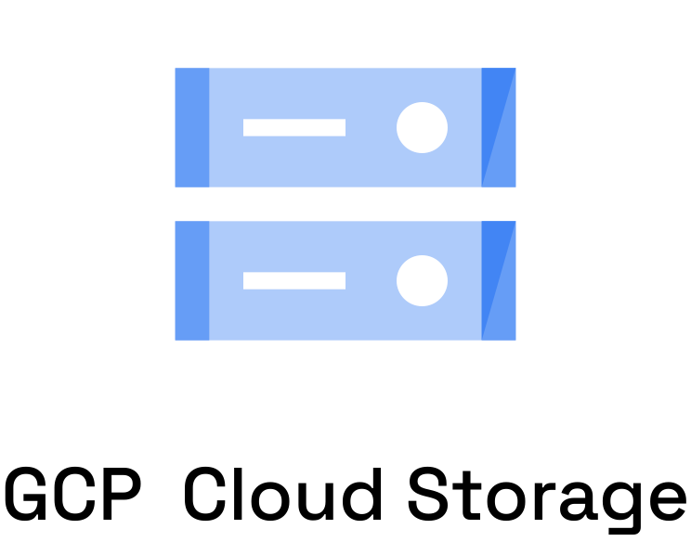

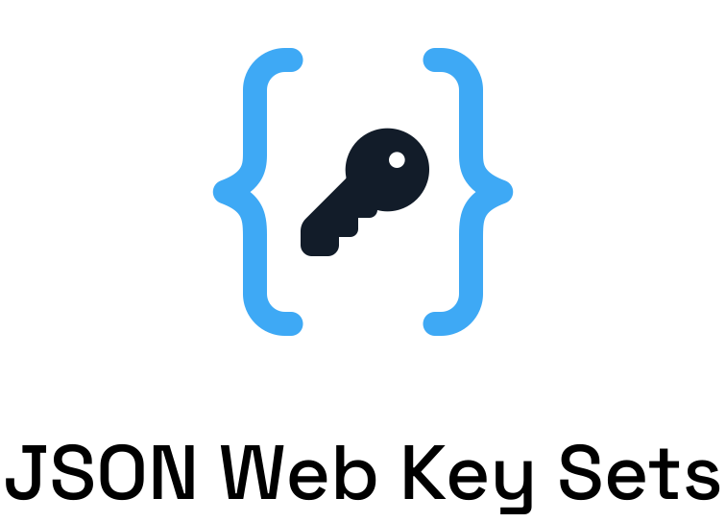










Dapr components
App

Slide 12
Service Invocation Demo
https://docs.dapr.io/getting-started/quickstarts/serviceinvocation-quickstart/

Slide 13



Service Invocation
Name resolution component for service discovery
Observability backend
DNS
Invoke method
Customer
Checkout
mTLS encryption
POST http://localhost:3500/v1.0/invoke/checkout/method/order
POST http://localhost:5100/order
Notes:
Name Resolution component for service discovery: mDNS, Kubernetes DNS, Hashicorp Consul

Slide 14
Service Invocation Demo
https://docs.dapr.io/getting-started/quickstarts/serviceinvocation-quickstart/

Slide 15
Publish / Subscribe API
https://docs.dapr.io/developing-applications/building-blocks/pubsub/

Slide 16


Publish / Subscribe
Observability backend
Cloudevents
Publisher
Message
broker
Subscriber
POST http://localhost:3500/v1.0/publish/mybroker/order-messages
POST http://localhost:5100/orders

Slide 17
Publish / Subscribe Demo
https://docs.dapr.io/getting-started/quickstarts/pubsub-quickstart/

Slide 18
Actors API
https://docs.dapr.io/developing-applications/building-blocks/actors/

Slide 19
Actors
- Uses the Virtual Actor pattern
- State is persisted in a configurable state store
- Uses turn-based access in concurrent systems
- Built-in actor distribution and fail-over
- Schedule period work using timers & reminders
- Author actors in C#, Java, JavaScript, Python and Go
- Use the Actors API with any language
The Actors API allows to write concurrent applications using the actor model.

Slide 20
Virtual Actor Model
Actor lifetime is not tied to their in-memory representation. No need to explicitly create or destroy an actor.
Notes:
Name Resolution component for service discovery: mDNS, Kubernetes DNS, Hashicorp Consul

Slide 21


Actor placement
Pod 1
My App
POST /v1.0/actors/MyActor/A/method/update
App Instance 1
MyActor A
3
2
1
MyActor B
Pod 2
Actor Type | Dapr Instances
MyActor | Partition1 Partition2
OtherActor | Partition 2
1
Placement Service
App Instance 2
MyActor C
OtherActor A
Notes:
Name Resolution component for service discovery: mDNS, Kubernetes DNS, Hashicorp Consul

Slide 22
Actors API
Invoke the update method on MyActor “A”
Create actor reminder
POST /v1.0/actors/MyActor/A/method/update
POST /v1.0/actors/MyActor/A/reminders/process
Save MyActor “A” state
Create actor timer
POST /v1.0/actors/MyActor/A/state
POST /v1.0/actors/MyActor/A/timer/process
Get MyActor “A” state
GET /v1.0/actors/MyActor/A/state/key
Notes:
Name Resolution component for service discovery: mDNS, Kubernetes DNS, Hashicorp Consul

Slide 23
Authoring Actors with .NET SDK
public interface ISmartDevice : IActor
{
Task<string> SetDataAsync(SmartDeviceData device);
Task<SmartDeviceData> GetDataAsync();
Task DetectSmokeAsync();
Task SoundAlarm();
Task ClearAlarm();
}
public class SmartDeviceData
{
public string Status { get; set; } = default!;
public string Location { get; set; } = default!; }
Notes:
Name Resolution component for service discovery: mDNS, Kubernetes DNS, Hashicorp Consul

Slide 24
Authoring Actors with .NET SDK
var deviceActorId1 = new ActorId("device1");
// Create a new instance of the data class that will be stored in the actor
var deviceData1 = new SmartDeviceData(){
Location = "First Floor",
Status = "Ready",
};
// Create the local proxy by using the same interface that the service implements.
// You need to provide the type and id so the actor can be located.
// If the actor matching this id does not exist, it will be created
var proxySmartDevice1 = ActorProxy.Create<ISmartDevice>(
deviceActorId1,
"SmokeDetectorActor");
// Now you can use the actor interface to call the actor's methods.
var setDataResponse1 = await proxySmartDevice1.SetDataAsync(deviceData1);
Notes:
Name Resolution component for service discovery: mDNS, Kubernetes DNS, Hashicorp Consul

Slide 25
Actors Demo
https://docs.dapr.io/getting-started/quickstarts/actors-quickstart/

